Slide 1
Entrez Search Engine
Finding Relevant Information in NCBI Databases
Dr. Muhammad Tahir
Assistant Professor
COMSATS University Islamabad,
Attock Campus
NOTE: Most slides derived from NCBI’s field guide

Slide 2
Structure of Entrez
Searching Relevant Information in NCBI DATABASE.
Search require data from multiples search engine.
Entrez is a cross-database search engine.
Search Engine.
Records are cross referenced and linked.
Simple ‘one box’ search.
DNA databases
Literature database
Protein databases
Genome projects
Taxonomy databases
Notes:
2

Slide 3
ENTREZ: A DISCOVERY SYSTEM
Pre-computed and pre-compiled data.
A potential “gold mine” of undiscovered relationships.
Used less than expected.
Word weight
PubMed abstracts
3-D Structure
Taxonomy
3 -D Structure
VAST
Phylogeny
Gene
Neighbors
Related Structures
BLAST
Nucleotide sequences
Protein sequences
BLAST
Neighbors
Related Sequences
Neighbors
Related Sequences
BLink
Domains
Hard Link

Slide 4
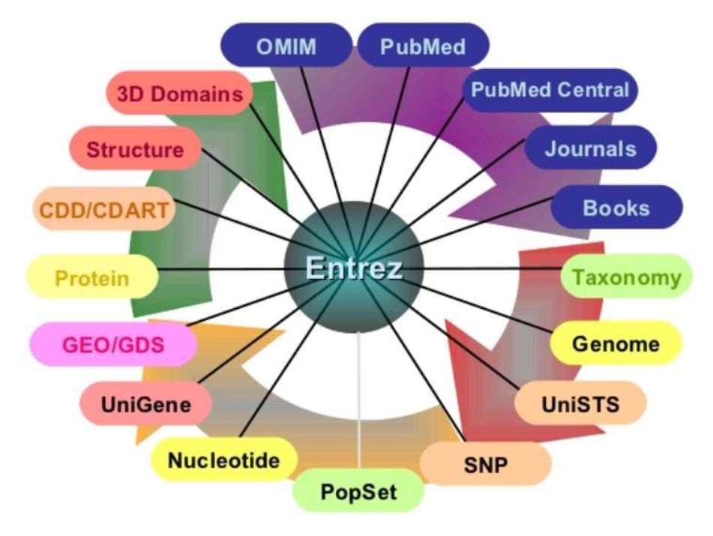
ENTREZ: The ever-expanding System

Slide 5
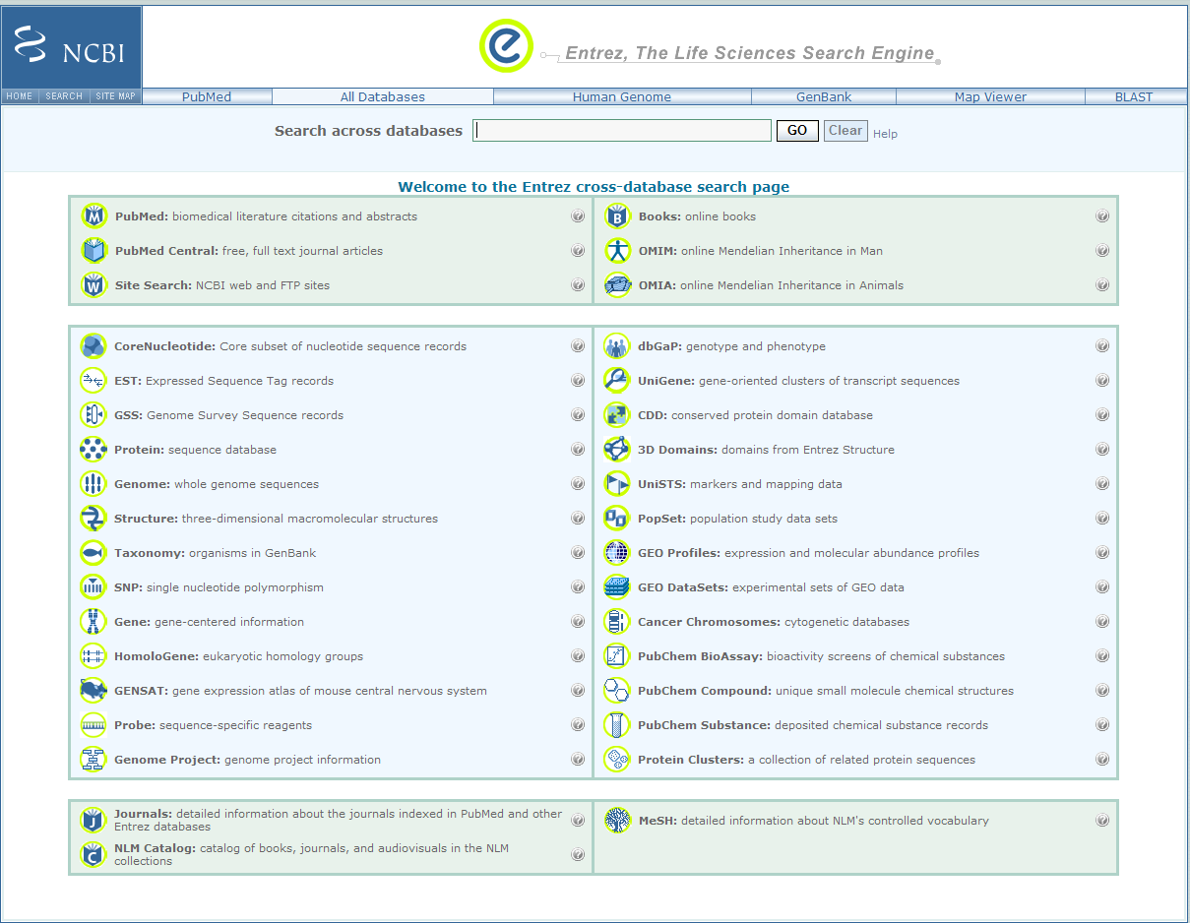
Entrez Main Screen

Slide 6
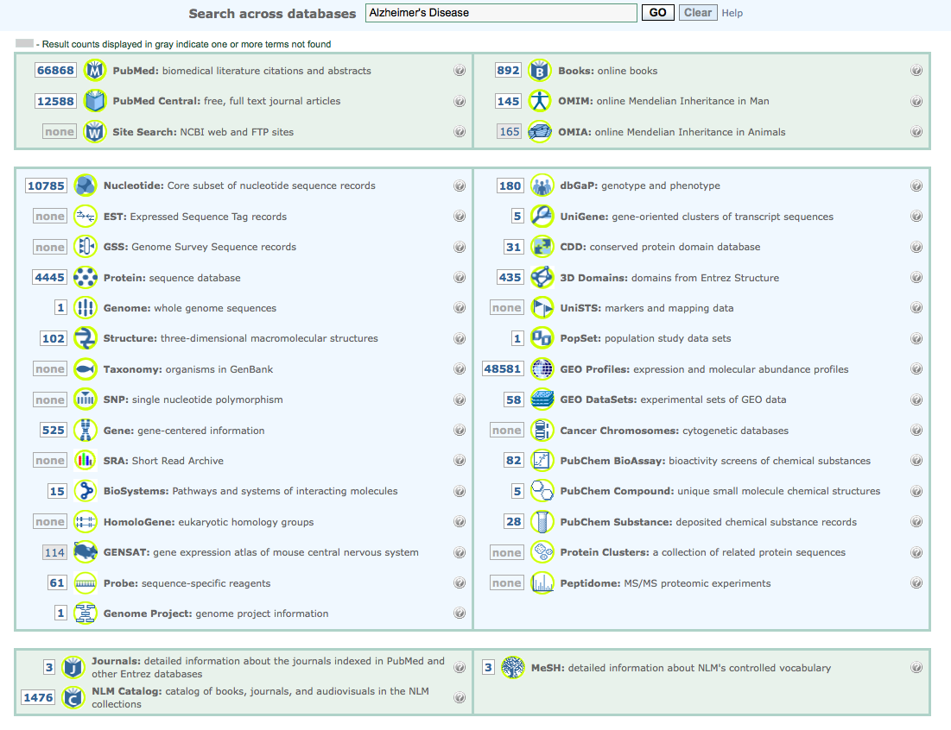
Global Query: All NCBI Databases
The Entrez system: 38 (and counting) integrated databases

Slide 7



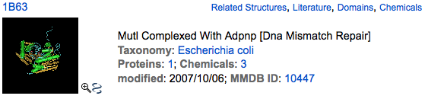
Traditional Method: The links menu
DNA Sequence
Nucleotide – Protein Link
Related Proteins
Protein – Structure Link
3-D Structure

Slide 8
The Problem
Rapidly growing databases with complex and changing relationships
Rapidly changing interfaces to match the above
Result
Many people don’t know:
Where to begin
Where to click on a Web page
Why it might be useful to click there

Slide 9
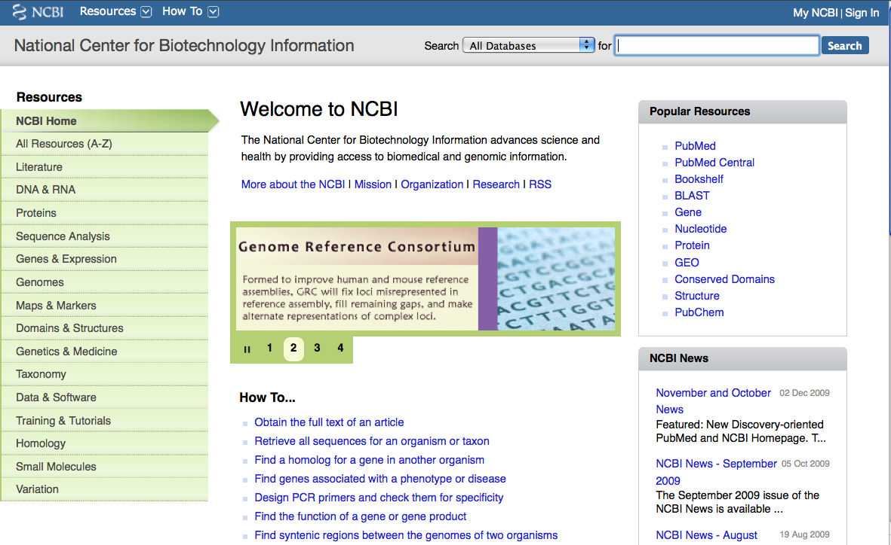
Global NCBI (Entrez) Search
colon cancer

Slide 10
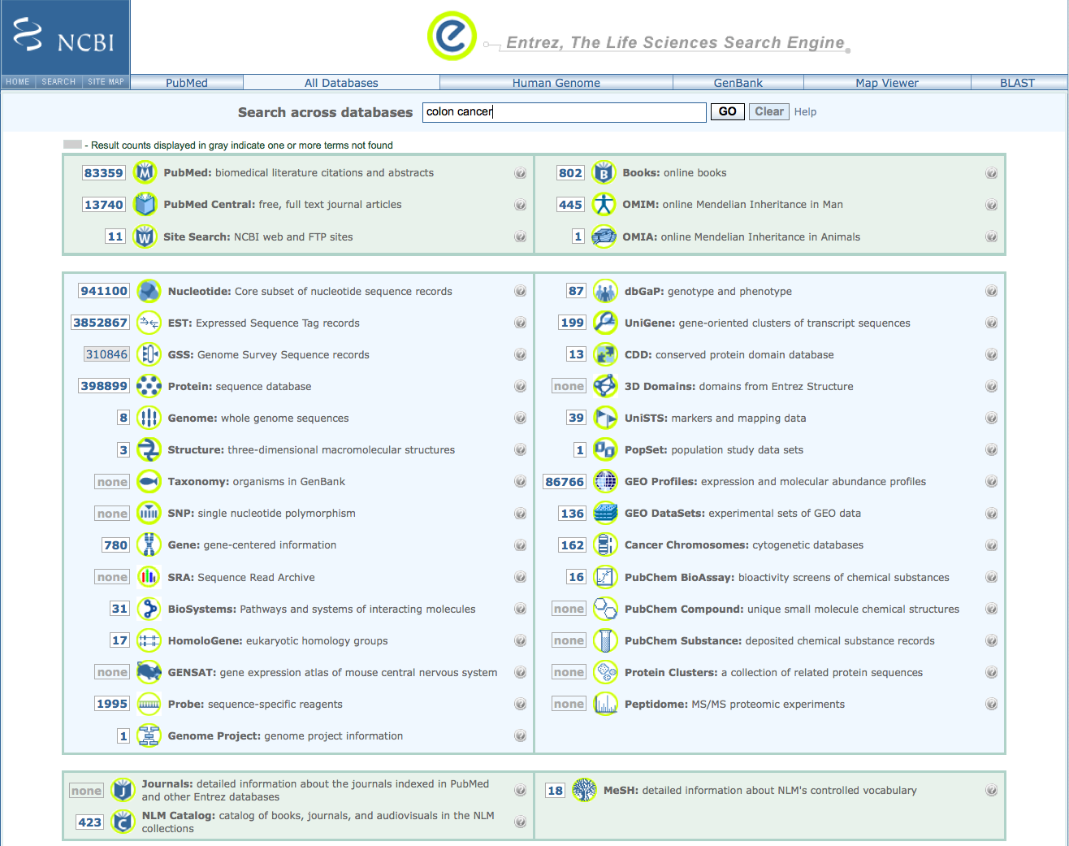
Global Entrez Search Results

Slide 11
ENTREZ TIP: START SEARCHES IN GENE
Entrez
Protein
BLink
Blink: BLAST Link
Gene
Other Entrez DBs
Homologene:
Gene Neighbors
HomoloGene
UniGene

Slide 12
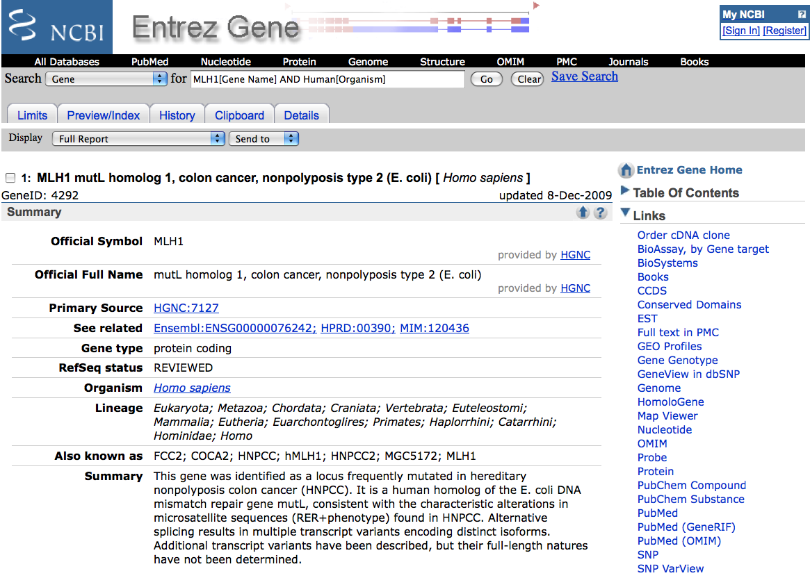
Precise Results
MLH1[Gene Name] AND Human[Organism]

Slide 13
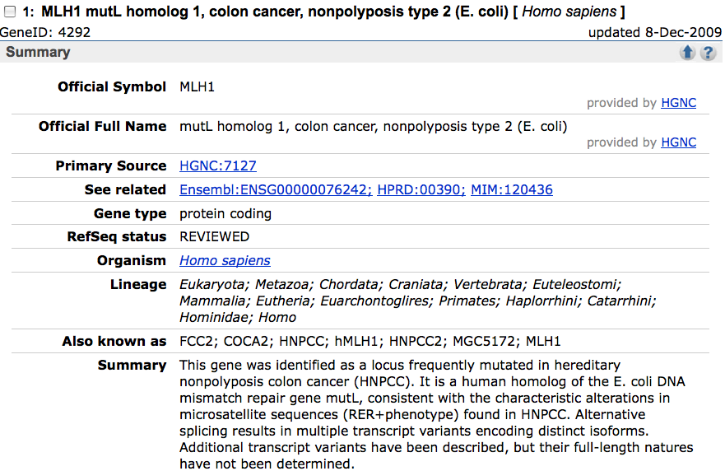
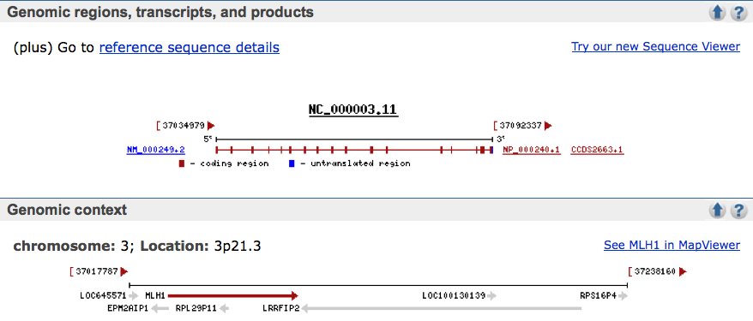
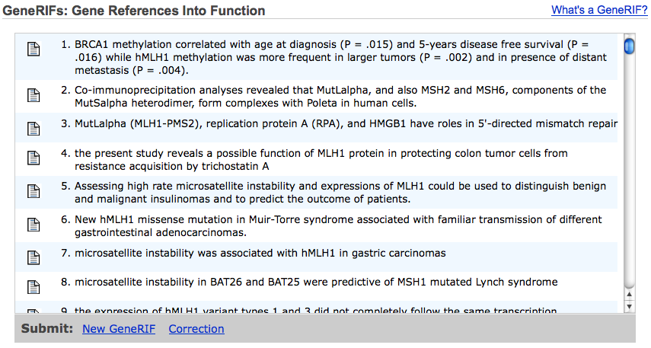
MLH1 Gene Record

Slide 14
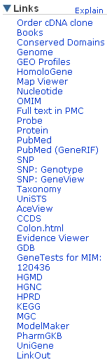
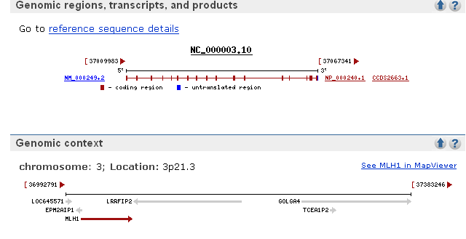
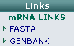
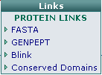
MLH1:Links to Sequence

Slide 15
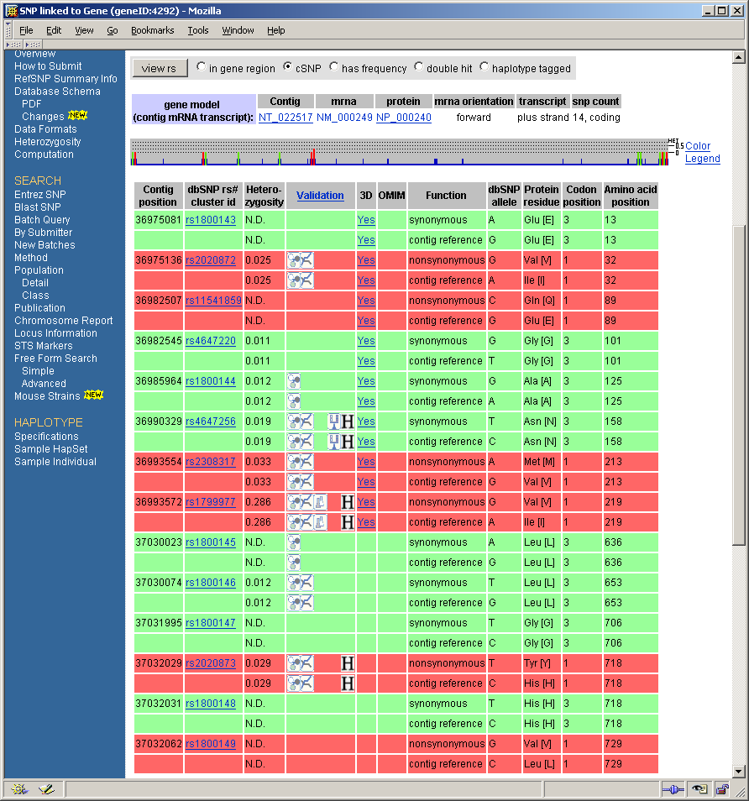
GENEVIEW: HUMAN MLH1 VARIATIONS
ATPase domain

Slide 16
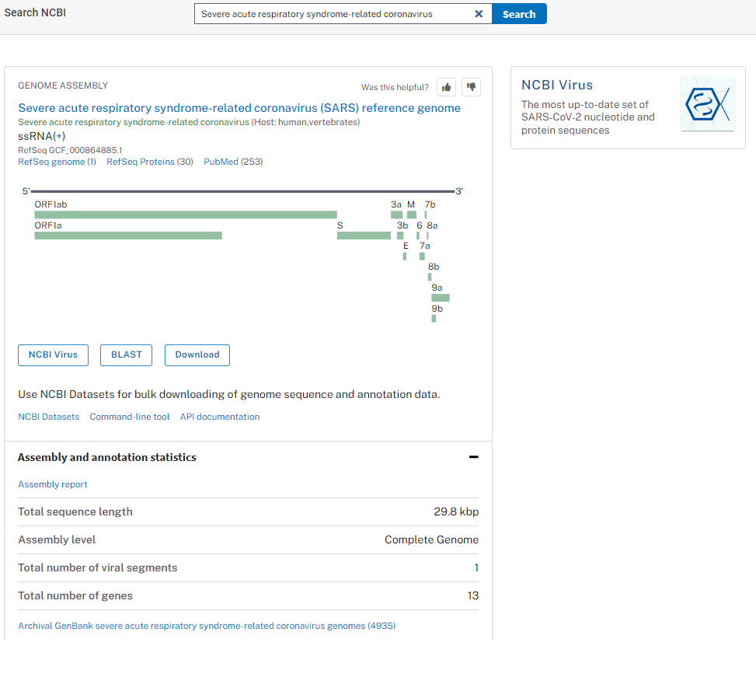
Entrez search by Example
https://www.ncbi.nlm.nih.gov/search/

Slide 17
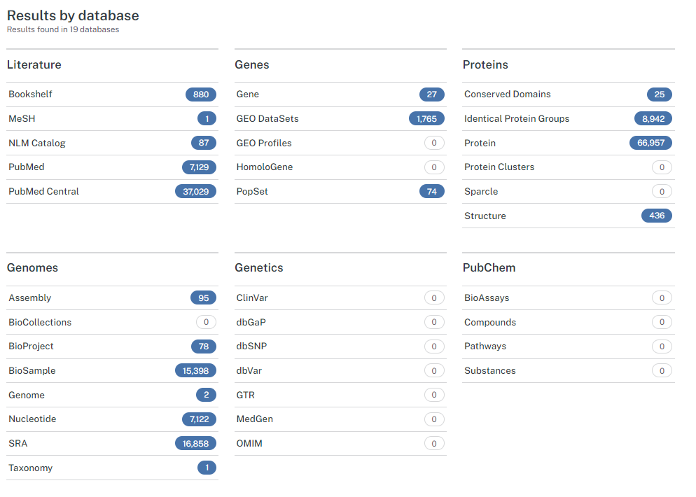

Slide 18
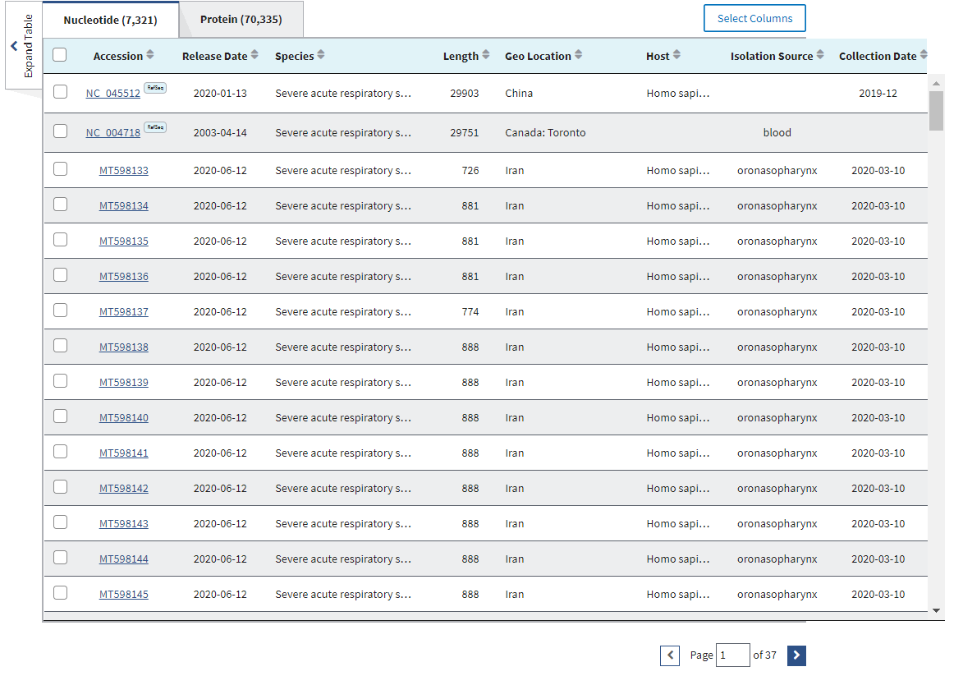
Click on
NCBI Virus

Slide 19
‘TAKE HOME MESSAGE’ ADVANTAGES OF DATA INTEGRATION
More relevant inter-related information in one place
Makes it easier to find additional relevant information related to your initial query
Potentially find information indirectly linked, but relevant to your subject of interest
uncover non-obvious genetic features that explain phenotype or disease
Easier to build a ‘story’ based on multiple pieces of biological evidence

Slide 20

Your Turn!
A little practice using Entrez.
Follow the instructions discussed in class
15 Minutes

